Slide 1

Universal App Development for Windows Platform for Beginners Lection 8: Integrating Web Content
Konstantin Kichinsky
konkich@microsoft.com | twitter.com/kichinsky
Microsoft

Slide 2
Why do I need web content inside my app?
Integrating local content
Ready to use assets (e.g. help resources).
HTML/CSS markup is easier (e.g. complex text).
App
WebView
Local files from app package

Slide 3
Why do I need web content inside my app?
Integrating web content
External content updated independently (e.g. app using agreement).
Authorization forms
App
WebView
Pages from internet

Slide 4
Why do I need web content inside my app?
Using ready components
There are ready to use JS-libraries/frameworks for my task (e.g. maps).
App
WebView
Local/External pages with JS-libraries

Slide 5
WebView in XAML
<!– Files in app package. -->
<WebView x:Name="webView1"
Source="ms-appx-web:///help/about.html"/>
<!– Files in local storage. -->
<WebView x:Name="webView2" Source="ms-appdata:///local/intro/welcome.html"/>
<!– Files from the web. -->
<WebView x:Name="webView3" Source="http://www.contoso.com"/>

Slide 6
WebView access from the code
// Page navigations
webView1.Navigate("ms-appdata:///local/intro/welcome.html");
// Events processing
webView1.DOMContentLoaded += webView1_DOMContentLoaded;
private void webView1_DOMContentLoaded(WebView sender, WebViewDOMContentLoadedEventArgs args)
{
// Show status.
if (args.Uri != null)
{
statusTextBlock.Text = "Content for " + args.Uri.ToString() + " has finished loading";
}
}

Slide 7
DEMO 01: Intro into WebView

Slide 8
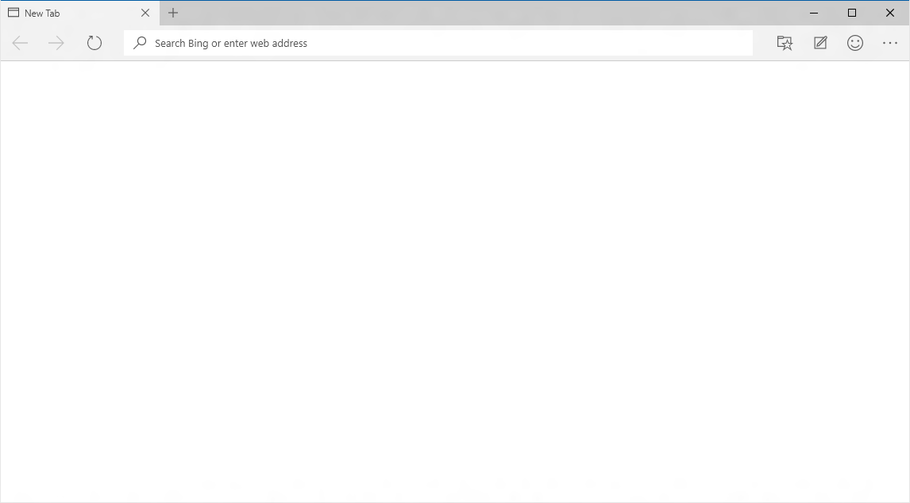
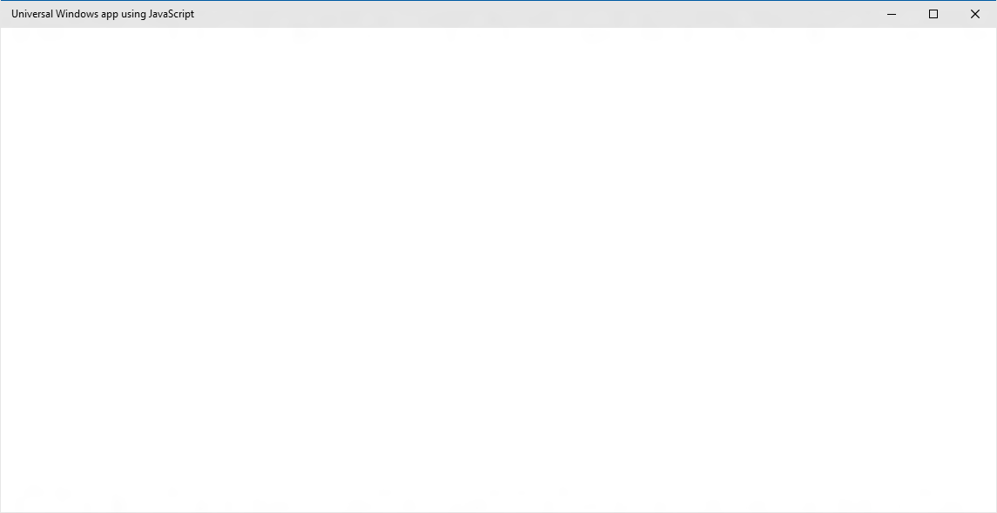

What is inside WebView?
The new engine shared with Microsoft Edge
EdgeHTML Chakra
App
EdgeHTML.dll
Chakra

Slide 9
Interacting with code inside WebView
InvokeScriptAsync
From C# to JS – invoking a method
window.external.notify + ScriptNotify
From JS to C# -- notifying with some data
AddWebAllowedObject
Passing a WinRT-object from C# to JS
Requires managing access policies

Slide 10
DEMO 02: Interacting with WebView

Slide 11
The next level
App C#/XAML
WebView
WebView
Local or external files
Starting with Windows 8, Windows Phone 8.1
Local code and markup
WinRT Access + Components
App
JS/HTML
Packaged App
Starting with Windows 10 (UWP Bridge for Web)
External code and markup
WinRT Access + Components
App JS/HTML
Hosted App

Slide 12
Hosted Web App
Reusing current investments
Development and deploy workflow Responsive design and adaptation to mobile scenarios
Flexibility in updating
App package – Windows Store Content – Web Server (Cloud)
.appx
UWP
HTML
CSS
JS

Slide 13
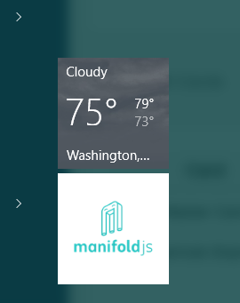
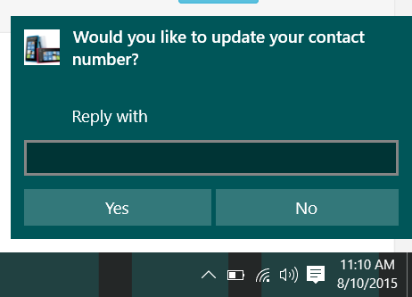
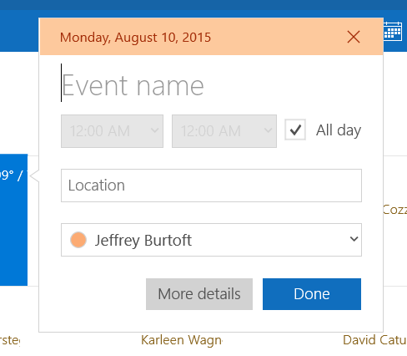
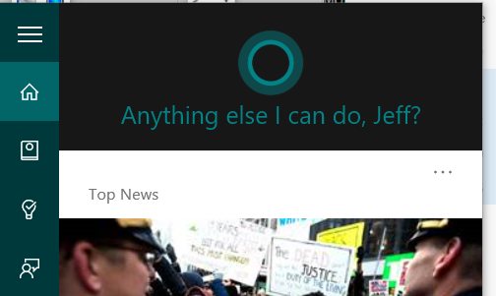
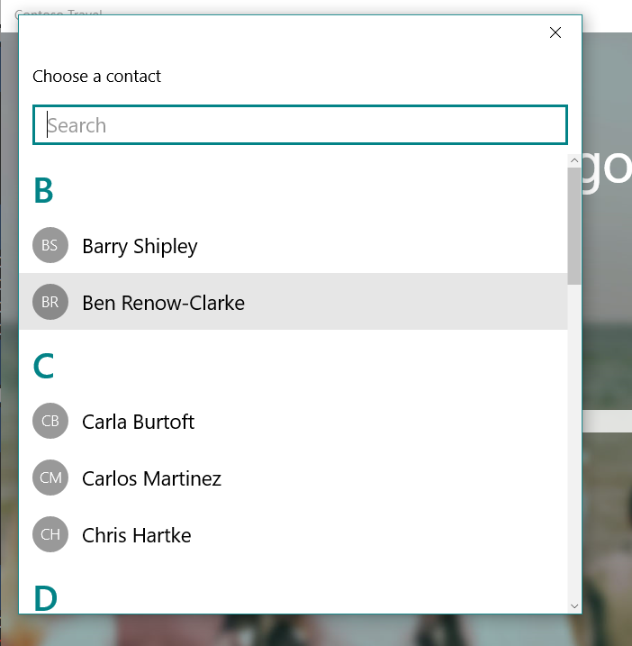
Hosted Web App
Full access to the Universal Windows Platform
Access rules managed thru app manifest

Slide 14
DEMO 03: Hosted Web App

Slide 15
Resume

Slide 16
Resume
Integrating web content
Use the most appropriate technology stack for each task
3 scenarios
C# + Web View (JS)
Packaged App (JS) + WinRT Components (C#)
Hosted App (JS) + WinRT Components (C#)

Slide 17
What else you should learn
Data transferring thru the network
WebAuthenticationBrocker
Basic scenarios: OAuth etc.
Apache Cordova
Packed App, Hosted App and cross-platform development

Slide 18

Contacts
Konstantin Kichinsky
Microsoft
konkich@microsoft.com & @kichinsky

